Slide 1
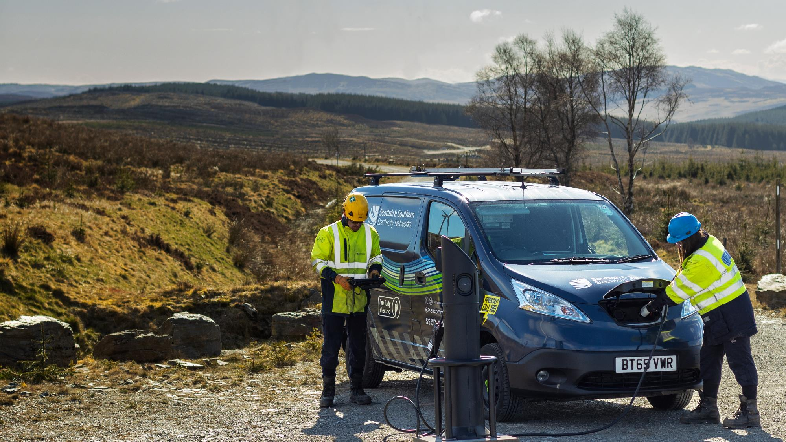
Customer Experience
Contact and Escalation Guide
SEPD

Slide 2
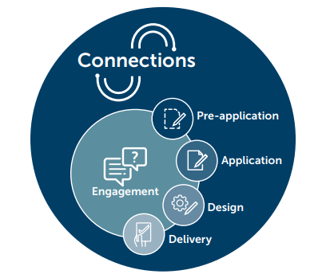
SSEN Connections
Contents
Scottish and Southern Electricity Networks (SSEN) operates in two licence areas; Scottish Hydro Electric Power Distribution (SHEPD) in northern Scotland and Southern Electric Power (SEPD) in central southern England. This guide outlines the contacts and escalations routes for out SEPD licence area.
Pre-application
Business Relationship Management 05-06
Contract Managers 07-11
Application
Application & Quote Acceptance 12
Minor Connection 13
Design
Design Managers 14
System Planning Managers 15
Delivery
Connections Delivery Managers 16
Large Capital Delivery Managers 17
Low Carbon Technologies
Flexible Solutions Team 18
Engagement
Customer Service, Vulnerability & Strategy 19
Customer Contact Centre / Legal 20
Escalation Route
Director of Customer Service 21
Heads of Connections 21
Compliments & Complaints 22
About this document
We are committed to offering our customers and stakeholders the very best in customer service. We are keen to equip you with the knowledge, tools and support you need to complete your connections, and provide you with as much information as possible about our processes and procedures to aid your connections journey.
This guide sets out the overarching stages of the connections journey and details the relevant contacts for each stage. It also provides escalation routes.

Slide 3

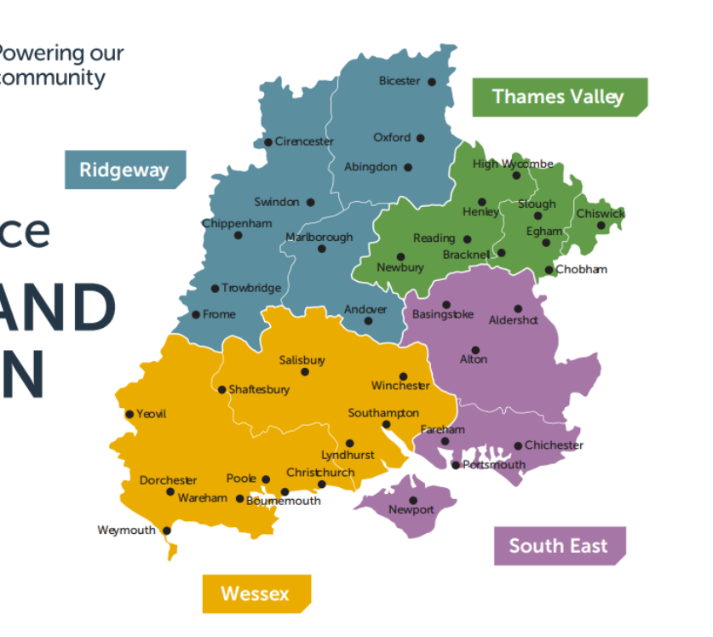


SEPD - Southern Electricity Power Distribution, is split into 4 regions:
Ridgeway
Thames Valley
Southeast
Wessex
SSEN Customer Connections activity in the Southern Electric Power Distribution (SEPD) area is split into 3 groups – detailed on the next page. The category caters for the delivery of Capex Connections within the four SEPD regions. Connections consist of substation, overhead lines and cable works required to construct a connection to the SEPD Network.

Slide 4
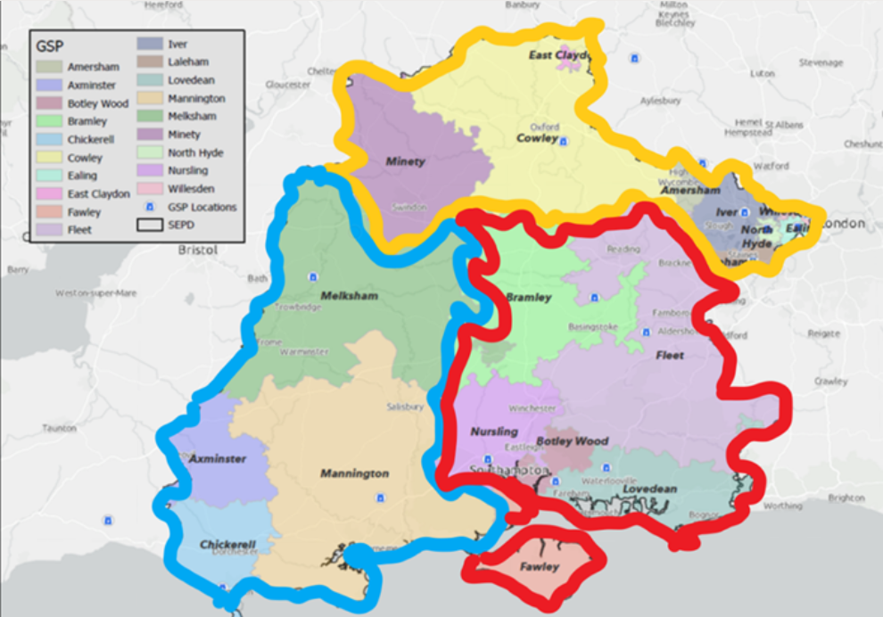
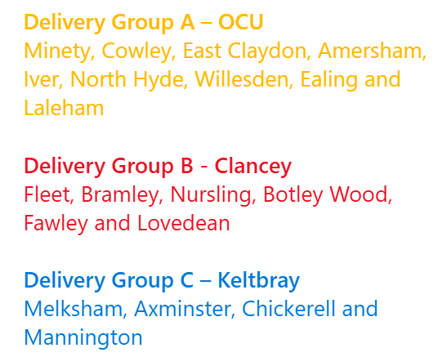
A/B/C represents the majors delivery groups. The delivery groups are structured around grid supply points (GSP) rather than regions in Majors, and GSPs are basically substations where the Transmission and Distribution networks meet. Each delivery group is headed up by a Project Director.
We also have a separate DGES (Distributed Generation Electricity Supply) team.

Slide 5
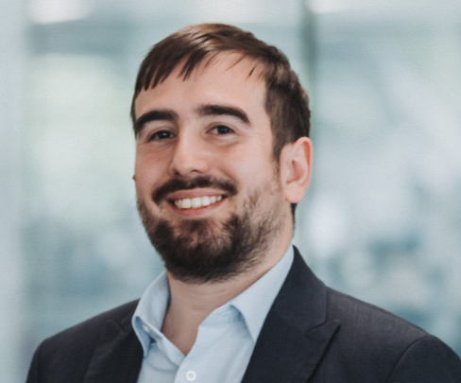
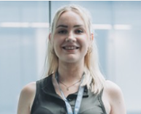
Stakeholder Engagement
Responsible for
The connections stakeholder engagement team oversees proactive engagement activity. This includes our customer conferences, market segment forums and focus groups. They also organise webinars and provide information resources on topics of interest within connections. The team analyses stakeholder feedback to form actions and commitments, to deliver continuous improvement for connections customers.
Michael Downey
Stakeholder Engagement Manager
michael.downey@sse.com
07342 026521
If you would like to book a meeting regarding one or more projects already in progress, please sign up to attend one of our monthly Connection’s Surgeries here:
www.ssen.co.uk/stakeholderevent/basicsearch/
businessrelationships@sse.com
Susannah Carter
Stakeholder Engagement Coordinator
susannah.carter@sse.com
Points of escalation
07493 776358
1st point of escalation is
Micheal Downey
Stakeholder Engagement Manager
2nd point of escalation is
Daniel Mellis
Senior Connections Strategy Manager
3rd point of escalation is
Mark Askew
Head of Connections, Policy & Performance

Slide 6



Business Relationship Management
Responsible for
Business Relationship Managers (BRMs) are fully responsible for the delivery of exceptional customer service for a specified customer segment in the major connections business. BRMs have responsibility for the relationship between SSEN and the customer segment assigned which could include ICPs, IDNOs, local councils, industry bodies and connection customers or large-scale projects. They are the single point of contract for the customer from pre-application through to delivery.
Mark Taylor
Relationship Manager
Local Authorities & Community Energy Groups
mark.j.taylor@sse.com
businessrelationships@sse.com
07876 837536
Our BRMs are involved throughout the connections journey and can be contacted at any stage. If you would like to book a meeting regarding one or more projects already in progress, please sign up to attend one of our monthly Connection’s Surgeries here:
www.ssen.co.uk/stakeholderevent/basicsearch/
Rebekah Rowson
Relationship Manager
Consultants, Commercial & Industrial
rebekah.rowson@sse.com
businessrelationships@sse.com
07721 509868
Points of escalation
1st point of escalation is
Group Lead Manager, A,B,C or DGES
Samantha Horrix (A)
Jack Klar (B)
Karris Small (C)
Emily Moore (DGES)
Laura Pearce
Relationship Manager
Housing Developers
EV & HP Installers
laura.pearce@sse.com
businessrelationships@sse.com
2nd point of escalation is
Austen Toone
Major Connections – Senior Manager
07880 914348
3rd point of escalation is
Craig Gilroyr
Head of Major Connections

Slide 7


Business Relationship Management
Responsible for
Business Relationship Managers (BRMs) are fully responsible for the delivery of exceptional customer service for a specified customer segment in the major connections business. BRMs have responsibility for the relationship between SSEN and the customer segment assigned which could include ICPs, IDNOs, local councils, industry bodies and connection customers or large-scale projects. They are the single point of contract for the customer from pre-application through to delivery.
Laura Huelin
Relationship Manager
businessrelationships@sse.com
laura.huelin@sse.com
IDNOs
Our BRMs are involved throughout the connections journey and can be contacted at any stage. If you would like to book a meeting regarding one or more projects already in progress, please sign up to attend one of our monthly Connection’s Surgeries here:
www.ssen.co.uk/stakeholderevent/basicsearch/
07493 776309
businessrelationships@sse.com
Points of escalation
Helen Robertson
Relationship Manager
1st point of escalation is
Group Lead Manager, A,B,C or DGES
Samantha Horrix (A)
Jack Klar (B)
Karris Small (C)
Emily Moore (DGES)
helen.robertson@sse.com
ICPs
07876 837305
businessrelationships@sse.com
2nd point of escalation is
Austen Toone
Major Connections – Senior Manager
3rd point of escalation is
Andrew Scott
Director of Customer Service

Slide 8




Pre-application (through to Delivery)
Lead Contract Managers
Delivery Group A – OCU
Minety, Cowley, East Claydon, Amersham, Iver, North Hyde, Willesden, Ealing and Laleham
Responsible for
Group A Lead
Samantha Horrix
Issuing all DGES and MAJP offers in line with SLC12
Addressing any contractual questions related to DGES and MAJP offers
Processing acceptances, issuing variations, payment schedules, and managing milestones for those schemes (specifically M1–M5, though this doesn’t need to be communicated to customers)
For schemes with an assigned Contract Manager, they should be the first point of contact for any contractual queries, challenges navigating SSEN, or contractual disputes.
07879 788812
commercial.contracts@sse.com
Delivery Group B - Clancey
Fleet, Bramley, Nursling, Botley Wood, Fawley and Lovedean
Group B Lead
Jack Klar
commercial.contracts@sse.com
07839 753 830
Group C Lead
Delivery Group C – Keltbray
Melksham, Axminster, Chickerell and Mannington
Karris Small
07377 067931
commercial.contracts@sse.com
Points of escalation
1st point of escalation is
Austen Toone
Major Connections – Senior Manager
DGES Lead
Emily Moore
Distributed Generation
Electricity Supply >50kW
2nd point of escalation is
Andrew Scott
Director of Customer Service
commercial.contracts@sse.com
07435 409551

Slide 9


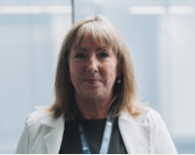


Pre-application (through to Delivery)
Contract Managers – Group A
Responsible for
Ruth Lundi
Kelly Heath
Issuing all DGES and MAJP offers in line with SLC12
Addressing any contractual questions related to DGES and MAJP offers
Processing acceptances, issuing variations, payment schedules, and managing milestones for those schemes (specifically M1–M5, though this doesn’t need to be communicated to customers)
For schemes with an assigned Contract Manager, they should be the first point of contact for any contractual queries, challenges navigating SSEN, or contractual disputes.
Contracts Manager
Contracts Manager
North Hyde, Ealing & Willesden
Iver, Laleham & Amersham
07443 175172
07467 395674
Linda Austin
Lorraine Karungi
Contracts Manager
Contracts Manager
Minety & East Claydon, East Claydon
Cowley
07918 778 886
07469 411935
Points of escalation
1st point of escalation is
Samantha Horrix
Lead Contracts Manager
Ana Loureiro
Projects Coordinator
2nd point of escalation is
Austen Toone
Major Connections – Senior Manager
commercial.contracts@sse.com
3rd point of escalation is
Andrew Scott
Director of Customer Service

Slide 10
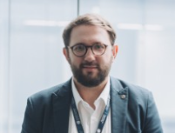

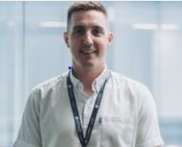

Pre-application (through to Delivery)
Responsible for
Contract Managers – Group B
Assisting allocated account portfolios with connections journey from pre-application to delivery
Ensuring Connection Offers are procured accurately and progressed efficiently upon acceptance
Arranging pre-application meetings and connections surgeries
Alisdair Marr
John Tucker
Contracts Manager
Contracts Manager
Fleet & Bramley
Lovedean
Our Connection Contract Managers are involved throughout the connections journey and can be contacted at any stage. If you would like to book a meeting regarding one or more prospective project(s), please contact
commercial.contracts@sse.com
If you would like to book a meeting regarding one or more projects already in progress, please sign up to attend one of our monthly connections surgeries here:
www.ssen.co.uk/stakeholderevent/basicsearch/
07586 281274
tbc
Tom Gray
Dami Adetunmbi
Contracts Manager
Projects
Coordinator
Nursling
Commercial.contracts@sse.com
07990 487221
Points of escalation
Shabanam Hussain
Contracts Manager
1st point of escalation is
Jack Klar
Lead Contracts Managers
Botley Wood & Fawley
2nd point of escalation is
Austen Toone
Major Connections – Senior Manager
07587 140672
3rd point of escalation is
Andrew Scott
Director of Customer Service

Slide 11




Pre-application (through to Delivery)
Responsible for
Contract Managers – Group C
Assisting allocated account portfolios with connections journey from pre-application to delivery
Ensuring Connection Offers are procured accurately and progressed efficiently upon acceptance
Arranging pre-application meetings and connections surgeries
Leanne Mclaughlin
Hannah Scantlebury
Contracts Manager
Projects Coordinator
commercial.contracts@sse.com
Mannington
Our Connection Contract Managers are involved throughout the connections journey and can be contacted at any stage. If you would like to book a meeting regarding one or more prospective project(s), please contact
commercial.contracts@sse.com
If you would like to book a meeting regarding one or more projects already in progress, please sign up to attend one of our monthly connections surgeries here:
www.ssen.co.uk/stakeholderevent/basicsearch/
07827 040678
Ememesi Ette
Contract Manager
Melksham
Points of escalation
07425 426771
Mark Watson
1st point of escalation is
Karris Small
Lead Contracts Managers
Contracts Manager
2nd point of escalation is
Austen Toone
Major Connections – Senior Manager
Axminster & Chickerell
07879 249825
3rd point of escalation is
Andrew Scott
Director of Customer Service

Slide 12


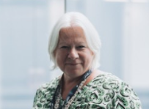

Pre-application (through to Delivery)
Responsible for
Contract Managers – DGES (Distributed Generation Electricity Supply
Assisting allocated account portfolios with connections journey from pre-application to delivery
Ensuring Connection Offers are procured accurately and progressed efficiently upon acceptance
Arranging pre-application meetings and connections surgeries
Hannah Hawley
Abigail Cooke
Thames Valley Region
Contracts Manager
Contracts Manager
Ridgeway Region
Our Connection Contract Managers are involved throughout the connections journey and can be contacted at any stage. If you would like to book a meeting regarding one or more prospective project(s), please contact
commercial.contracts@sse.com
If you would like to book a meeting regarding one or more projects already in progress, please sign up to attend one of our monthly connections surgeries here:
www.ssen.co.uk/stakeholderevent/basicsearch/
07353 157266
07879 369520
Claire Graham
Contracts Manager
Wessex Region
07436 491626
Points of escalation
Ronnie Calladine
1st point of escalation is
Emily Moore
Lead Contracts Manager
Contracts Manager
Southeast Region
2nd point of escalation is
Austen Toone
Major Connections – Senior Manager
07918 303665
3rd point of escalation is
Andrew Scott
Director of Customer Service

Slide 13
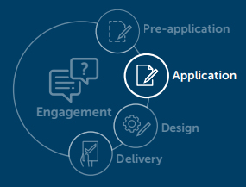



Application Team Managers
Applications & Quote Acceptance
Rowena Langford
Danielle Humby
Responsible for
Microgen Team Manager
Digital Demand Applications – Team Manager
Raising applications
Taking payments
Providing guidance on application and quotation process
North & South Microgen application
rowena.langford@sse.com
danielle.humby@sse.com
Our Application & Quote Acceptance team are happy to provide help and advice on the application and quote acceptance process via phone or email. Applications can be raised via phone, email or online
connections@ssen.co.uk
0800 048 3516
connections@ssen.co.uk
connections@ssen.co.uk
Shelley O’Connor
Karen Vilday
Digital Demand Applications – Team Manager
MCC and EVHP Team Manager
Connections acceptance & customer payments
shelley.o’connor@sse.com
karen.vilday@sse.com
connections@ssen.co.uk
connections@ssen.co.uk
Points of escalation
Kerrie Coan
1st point of escalation is
Application Team Managers
Telephony Team Manager
Minor connection applications & all connections enquiries
2nd point of escalation is
Jacob Coates
Decarbonisation Application Performance Manager
kerrie.coan@sse.com
connections@ssen.co.uk
3rd point of escalation is
Hayley Joynson
Head of Minor Customer Connections
4th point of escalation is
Andrew Scott
Director of Customer Service

Slide 14
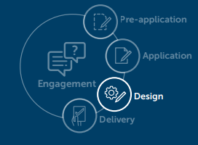

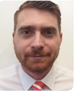
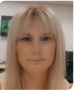
Minor Customer Connections Managers
Jacob Coates
Michael Hammond
Responsible for
Decarbonisation Application and Workforce Planning Performance Manager
Minor Connections Design Manager
Managing our Connections Service Centre for all customer applications
Assists our Minor Connections Customers throughout their journey from application all the way through to the delivery of the project
Process acceptances and payments for connections quotes
Drives the development for self service and automation of quoting
Manages the financial closure of projects
Jacob.coates@sse.com
michael.hammond@sse.com
07443 183350
Gemma Overall
Minor Connections Financial Reconciliation Manager
gemma.overall@sse.com
07721 505094
Points of escalation
1st point of escalation is
Minor Customer Connections Managers
2nd point of escalation is
Hayley Joynson
Head of Minor Connections
3rd point of escalation is
Andrew Scott
Director of Customer Service

Slide 15

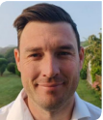
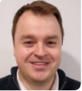

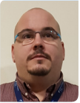
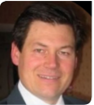
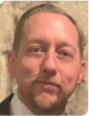
Design Managers
Responsible for
Mark Wickham
Lead Design Manager
Designing & quoting required works for your connection
Providing guidance on design and quotation processes
Assessment of the network to ensure everything is within the allowances
Leads the Design Managers (excluding major DG projects)
mark.wickham@sse.com
07810 858177
Kyran Bichard
Phillip McGuinness
Our Design team are happy to provide help and advice on the design and quotation process via phone or email If you would like to book a meeting regarding one or more prospective project(s), please contact
businessrelationships@sse.com
If you would like to book a meeting regarding one or more projects already in progress, please sign up to attend one of our monthly Connections Surgeries here:
www.ssen.co.uk/stakeholderevent/basicsearch/
Design Manager
Design Manager
Wessex region
Ridgeway Region
kyran.bichard@sse.com
phillip.mcguiness@sse.com
07827 044119
07471 347361
Mark Collis
Nick Palmer
Design Manager
Design Manager
All regions
Large Generation, Out of Area, Design Approval
Thames Valley region
mark.collis@sse.com
07741 777201
nicholas.palmer@sse.com
07825 015108
Points of escalation
James Stapley
Mike Rogers
1st point of escalation is
Design Mangers
Design Manager
EHV Design Manager
Southeast region
All regions
2nd point of escalation is
Richard Mailer
Head of Connections, Design & Quotation SEPD
james.stapley@sse.com
mike.rogers@sse.com
07776 603563
07767 850380
3rd point of escalation is
Andrew Scott
Director of Customer Service

Slide 16
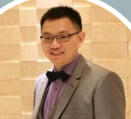


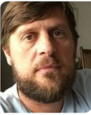
System Planning Managers
Responsible for
Yuan Gao
Rula Sha
System Planning Manager
System Planning Manager
System Planners are responsible for assessing and designing improvements to our existing equipment and ensuring compliance with legal requirements.
They play a crucial part in enhancing the safety, security, and reliability of our electricity network and also help to find innovative solutions to support both current and future power demands .
Minety, Melksham, Cowley & East Claydon
Botley Wood, Lovedean, Fawley, Nursling, Mannington, Axminster, Chickerell
yuan.gao@sse.com
rula.sha@sse.com
0118 534755
0118 534755
Ricardo Dias
Rafael Rigoni
System Planning Managrr
System Planning Manager
Botley Wood, Lovedean, Fawley, Nursling, Mannington, Axminster, Chickerell
Ealing, Willesden, Laleham, North Hyde, Iver 66kV, Iver 132kV, Amersham
ricardo.dias@sse.com
rafael.rigoni@sse.com
Points of escalation
07423 455472
01738 275924
1st point of escalation is
Lead System Planners
2nd point of escalation is
James Hurley
Head of Engineering and Investment
3rd point of escalation is
Andrew Roper
Director of DSO

Slide 17
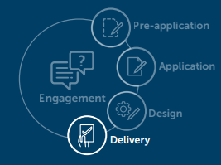
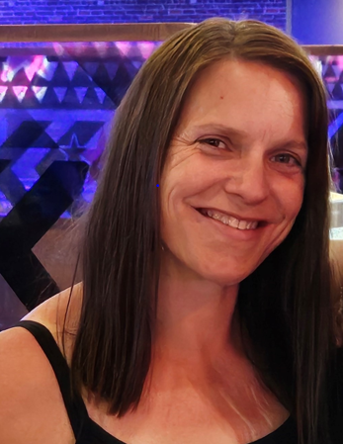


Delivery Managers
Large Connections
Angela King
Jennifer Morris
Responsible for
Delivery Manger
Delivery Manger
Carrying out onsite works including land rights
Delivering your connection
Providing guidance on the delivery process
Large Connections - M4 Corridor Ridgeway, Thames Valley
Large Connections – South Coast Southeast & Wessex
angela.king@sse.com
jennifer.morris@sse.com
Our Connections Delivery team are split into four key areas:
07342 028113
07990 494179
Major Projects: Large connections requiring 33/132kV works
Large Connections: 4 or more new connections, 1 supply larger than 69kva, diversions, disconnections
Competition in Connections (CiC): Connections projects for Independent Connection Providers or Independent Distribution Network Operators
Minor Connections: Up to 4 new connections or 1 new supply up to 69kva, Service Alterations (see next page for team)
Competition in Connections
Jevan Laxan
Delivery Manger
Competition in Connections
jevan.laxan@sse.com
Points of escalation
07384 802582
1st point of escalation is
Delivery Managers
2nd point of escalation is
Craig Gilroy
Head of Major Connections
3rd point of escalation is
Andrew Scott
Director of Customer Service

Slide 18
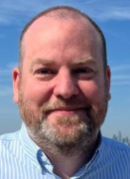
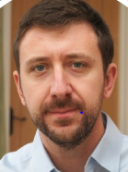
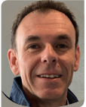
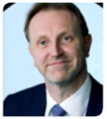
Large Capital Delivery
Responsible for
Major Projects and Large connections requiring 33/132kV works
Major Projects and Large connections requiring 33/132kV works
Large Capital Delivery is responsible for all large capital and customer connection projects
Delivery Groups are structured around grid supply points;
Each Delivery Group will be headed by a Project Director with senior project managers having responsibility for managing all projects within individual Grid Supply Points
Project managers have responsibility for delivery of individual projects.
Delivery Contract Partners will be appointed to each Delivery Group (tender currently in progress)
Ian Burnham
Head of Programme Delivery South
ian.burnham@sse.com
07525 951781
Carl Pates
Project Director –
Delivery Group A
carl.pates@sse.com
07385 085197
Points of escalation
Neil Hitchcock
David Grant
Project Director –
Delivery Group B
Project Director –
Delivery Group C
1st point of escalation is
Project Directors
neil.hitchcock@sse.com
david.grant@sse.com
2nd point of escalation is
Ian Burnham
Head of Programme Delivery South
3rd point of escalation is
Fraser Hood
Director of Large Capital Project Delivery

Slide 19

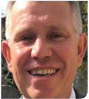
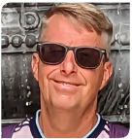
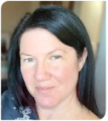
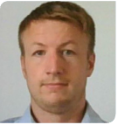
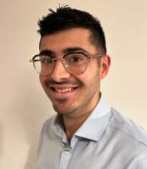
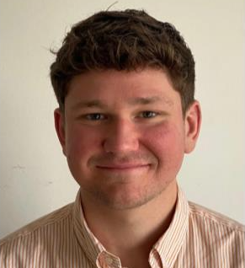
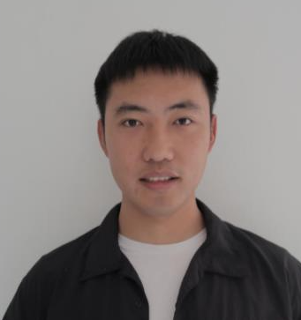
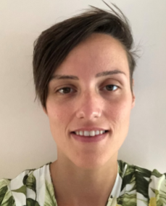
Flexible Services
Gavin Stewart
Mark Homann
Flexible Solutions Manager
Lead Project Delivery Manager
gavin.stewart@sse.com
mark.homann@sse.com
Responsible for
07767 850006
07584 313225
Dean Miles
Jenny Lindsay
Flexible Solutions Delivery Engineer
Flexible Solutions Support Technician
Overseeing the roll out of certain proven innovations that require more support once they have been installed and commissioned.
Currently this means they are responsible for rolling out Active Network Management and other types of flexible connections across both our distribution areas, north and south for the benefits of your connection and to the UK customer in general.
If you have any queries in regard to Flexible Connection opportunities, please contact:
flexible.connections@sse.com
dean.miles@sse.com
jenny.lindsay@sse.com
07747 559091
07443 173311
Iain Prentice
Oliver Cooper
Flexible Solutions Delivery Engineer
Flexible Solutions Project Manager
iain.prentice@sse.com
oliver.cooper@sse.com
07342 027519
07425 426830
John Boundy
Jiabin Fan
Flexible Solutions Project Engineer
Flexibility Scheduling Engineer
john.boundy@sse.com
jiabin.fan@sse.com
Points of escalation
07342 027805
07493 881672
Corinna Farrell
1st point of escalation is
Gavin Stewart
Flexible Solutions Manager
Flexible Solutions Performance Manager
corinna.farrell@sse.com
07385 430460

Slide 20
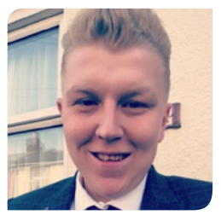
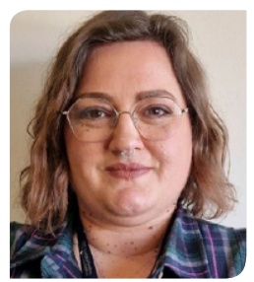
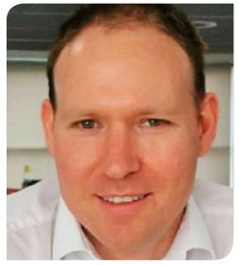
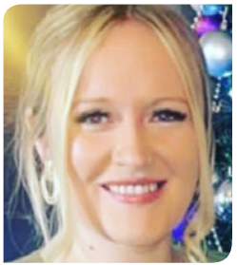
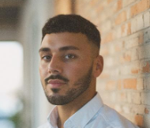

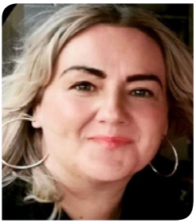
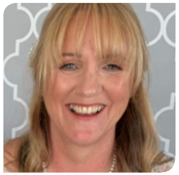
Customer Service, Vulnerability & Strategy
Responsible for
Customer Service Strategy for SSEN
ED2 Customer Strategy Objectives
Customer Vulnerability Strategy
Service Design Authority for SSEN
Customer Change & Improvement portfolio
Strategic oversight of welfare during storms & welfare/ manual framework
PSR Social Obligations & Strategy
Customer Digital Strategy & Website ownership
Customer Performance & Standards. Insight Analysis & Reporting
Troy Fisher
Emma Merritt
Customer Journey & Experience Design Lead
Customer Vulnerability & Communities Lead
troy.fisher@sse.com
emma.merritt@sse.com
07887 943075
07469 411043
David Yule
Customer Business Improvement & Planning Lead
david.yule@sse.com
Engage with us
Rebecca Priestley
Bradley Smith
Sign up to our Connections mailing list
View our event calendar
Visit our Webpage
Journey Owner – Minor Connections & General Enquiries
Journey Owner – Digital
rebecca.priestley@sse.com
bradley.smith@sse.com
07810 817502
07586 282010
Abigail Furey
Jane Bakella
Points of escalation
Journey Owner – Large & Major Connections
Journey Owner – Interruptions & Complaints
abigail.furey@sse.com
jane.bakella@sse.com
1st point of escalation is
Troy Fisher
Customer Journey & Experience Design Lead
07436 491626
01738 344607
Debbie Cloke
2nd point of escalation is
Andrew Bailey
Head of Customer Service & Stakeholder Strategy
Engagement Coordinator
debbie.cloke@sse.com
07741 127752
3rd point of escalation is
Andrew Scott
Director of Large Capital Project Delivery

Slide 21
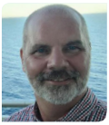
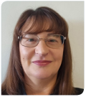



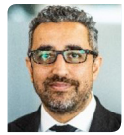
Customer Contact Centres
Mark Wells
Lorraine Barber
Performance Manager - North
Performance Manager - South
mark.wells@sse.com
lorraine.barber@sse.com
Responsible for
07920 237540
07990 424985
Aimee Wiles
Jade Law
Interface with the SSEN customer for faults & general enquiries
Customer interface during storms
Written, digital, telephony & verbal interaction with customers
Customer complaints & executive complaints
Resource management of Contact Centres
Performance Manager – GE and Social Media
Complaints Manager
aimee.wiles@sse.com
jade.law@sse.com
07496 869728
07920 167987
Louise Jones
Social Obligations Manager
louise.jones@sse.com
Legal
Points of escalation
Raaj is a commercial property solicitor and is the Head of Legal (Property) Distribution, based in our Reading office, advising on property, planning and environmental issues.
Raaj leads a team of 10 lawyers based across Reading, Perth, Glasgow and Inverness. His team spend most of their time working on real estate transactions for SEPD / SHEPD. Between the in-house team and the external panel firms, Raaj steers c.3,000 live transactions
Raaj Bains
1st point of escalation is
Jade Law
Complaints Manager
Head of Legal
raaj.bains@sse.com
07876 837450
2nd point of escalation is
Gemma Wilson
Head of Customer Contact Centres
3rd point of escalation is
Andrew Scott
Director of Customer Service

Slide 22
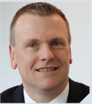
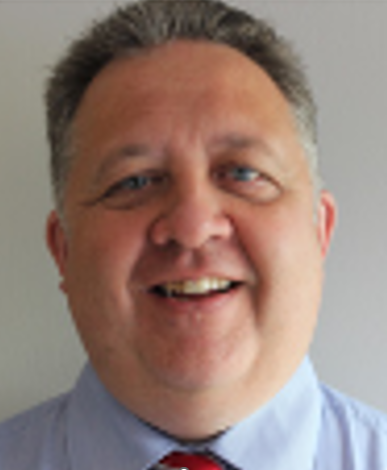


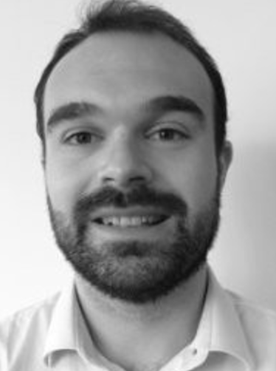


Escalation Route for South (SEPD)
The end-to-end connections customer journey is the sole responsibility of the Customer Service Directorate. This change, brought about in 2023, provides our customers and stakeholders visibility of staff responsibility and accountability throughout the journey, from application to delivery.
Responsible for
Our networks business is split into four regions, each with a dedicated leadership team; Ridgeway, Wessex, Thames Valley and Southeast.
Andrew Scott
Director of Customer Service
andrew.m.scott@sse.com
Paul Towsey
Richard Mailer
Hayley Joynson
TBC
Interim Head of Delivery
Head of Connections Design & Quotation (South)
Head of Major Connections
Head of Minor Customer Connections
paul.towsey@sse.com
richard.mailer@sse.com
hayley.joynson@sse.com
07500 912995
07767 850459
Mark Askew
Andrew Bailey
Gemma Wilson
Head of Connections, Policy & Performance
Head of Customer Service Strategy & Vulnerability
Head of Customer Contact Centres
mark.askew@sse.com
gemma.wilson@sse.com
andrew.bailey2@sse.com
07919 907484

Slide 23




Compliments & Complaints
Engage with us
Sign up to our Connections mailing list
View our event calendar
Read our regulatory ICE submissions
Visit our Webpage
Compliments
We are keen to hear your good news stories and positive experiences with our team members. If you have received particularly good service, why not commend the person or team responsible? It lets us know what we are doing right, highlights good working practices that we can all adopt and encourages certain ways of working. Compliments can be sent to the Connections Engagement team at:
Engage with us on social media
Click here
customerexperience@sse.com
Click here
Complaints
We always aim to provide the best service possible, however we do understand that sometimes we don’t always get it right. If you should experience this, and would like to raise a complaint you can do this via telephone, email or online
The easiest and quickest way to resolve a complaint is to telephone us: 0800 980 1395
Monday to Saturday between 08:00 – 16:00
If you are unable to phone or would prefer to write, you can contact us by email:
customercomplaints@ssen.co.uk
You can also complete our online complaints form: www.ssen.co.uk/Complaints
Click here
Click here
If you have any ideas for improvement of this guide please let us know:
customerexperience@sse.com
businessrelationships@sse.com
Notes:
Hyperlinks to be included

