Slide 1
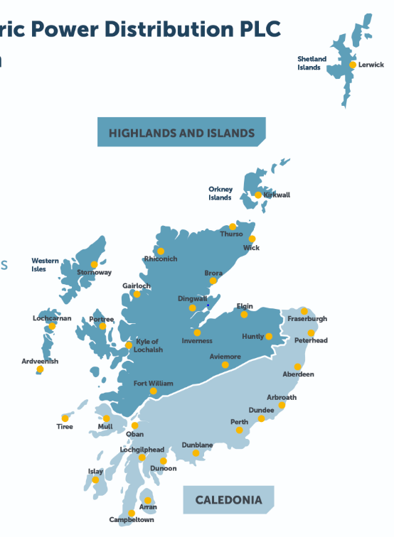


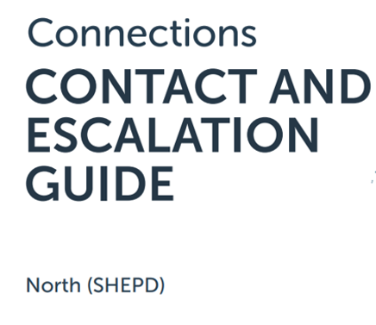

Slide 2
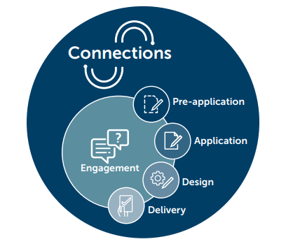
SSEN Connections
Contents
Scottish and Southern Electricity Networks (SSEN) operates in two licence areas; Scottish Hydro Electric Power Distribution (SHEPD) in northern Scotland and Southern Electric Power (SEPD) in central southern England. This guide outlines the contacts and escalations routes for out SEPD licence area.
Pre-application
Business Relationship Management 03
Contract Managers 04-05
Application
Application & Quote Acceptance 06
Minor Connection 07
Design
Design Managers 08
System Planning Managers 09
Delivery
Connections Delivery Managers 10
Minor Connection Delivery Team Managers 11
Large Capital Delivery Managers 12-13
Low Carbon Technologies
Flexible Solutions Team 14
Engagement
Customer Service, Vulnerability & Strategy 15
Customer Contact Centre / Legal 16
Escalation Route
Director of Customer Service 17
Heads of Connections 17
Compliments & Complaints 18
About this document
We are committed to offering our customers and stakeholders the very best in customer service. We are keen to equip you with the knowledge, tools and support you need to complete your connections, and provide you with as much information as possible about our processes and procedures to aid your connections journey.
This guide sets out the overarching stages of the connections journey and details the relevant contacts for each stage. It also provides escalation routes.

Slide 3
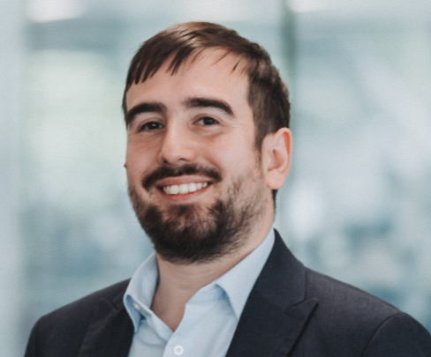

Stakeholder Engagement
Responsible for
The connections stakeholder engagement team oversees proactive engagement activity. This includes our customer conferences, market segment forums and focus groups. They also organise webinars and provide information resources on topics of interest within connections. The team analyses stakeholder feedback to form actions and commitments, to deliver continuous improvement for connections customers.
Michael Downey
Stakeholder Engagement Manager
michael.downey@sse.com
07342 026521
If you would like to book a meeting regarding one or more projects already in progress, please sign up to attend one of our monthly Connection’s Surgeries here:
www.ssen.co.uk/stakeholderevent/basicsearch/
businessrelationships@sse.com
Susannah Carter
Stakeholder Engagement Coordinator
susannah.carter@sse.com
Points of escalation
07493 776358
1st point of escalation is
Micheal Downey
Stakeholder Engagement Manager
2nd point of escalation is
Daniel Mellis
Senior Connections Strategy Manager
3rd point of escalation is
Mark Askew
Head of Connections, Policy & Performance

Slide 4
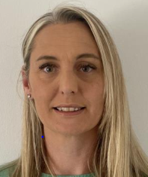

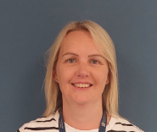

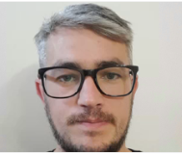
Application (through to Delivery)
Responsible for
* Issuing all DGES and MAJP offers in line with SLC 12
Addressing any contractual questions related to DGES and MAJP offers
Processing acceptances, issuing variations, payment schedukes and supporting with the milestones of those schemes
For schemes with an assigned Contract Manager, they should be the first point of contact for any contractual queries, challenges navigating SSEN, or contractual disputes
Contract Managers
Tanya Robertson
Lead Contracts Manager
07389 758211
commercial.contracts@sse.com
Kirsty Garvie
Kirsty Stephen
Contracts Manager
Contracts Manager
South Caledonia
South Caledonia
07825 014133
07825 014133
commercial.contracts@sse.com
commercial.contracts@sse.com
Points of escalation
Kira Scott
John Colquhoun
Project Coordinator
1st point of contact is your
Contracts Manager
Contracts Manager
South Caledonia
All regions
SHEPD
07918 888664
2nd point of contact is Tanya Robertson
Lead Contracts Manager
commercial.contracts@sse.com
commercial.contracts@sse.com
3rd point of contact is Austen Toone
Senior Manager – Major Connections
07879 969033

Slide 5

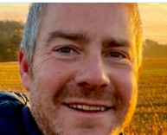

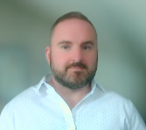
Application (through to Delivery)
Responsible for
* Issuing all DGES and MAJP offers in line with SLC 12
Addressing any contractual questions related to DGES and MAJP offers
Processing acceptances, issuing variations, payment schedukes and supporting with the milestones of those schemes
For schemes with an assigned Contract Manager, they should be the first point of contact for any contractual queries, challenges navigating SSEN, or contractual disputes
Contract Managers
Ian Jessiman
Gavin Mackintosh
Contracts Manager
Contracts Manager
North Caledonia & Highlands & Islands
Highlands & Islands
07469 411438
07990 490223
commercial.contracts@sse.com
commercial.contracts@sse.com
Andy Crumley
Jamie Robertson
Contracts Manager
Contracts Manager
Points of escalation
Highlands & Islands
North Caledonia
07586 286862
1st point of contact is your
Contracts Manager
07342 027828
commercial.contracts@sse.com
commercial.contracts@sse.com
2nd point of contact is Tanya Robertson
Lead Contracts Manager
3rd point of contact is Austen Toone
Senior Manager – Major Connections
07879 969033

Slide 6
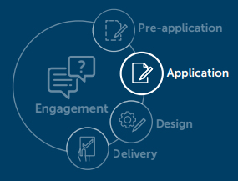



Application Team Managers
Applications & Quote Acceptance
Rowena Langford
Danielle Humby
Responsible for
Microgen Team Manager
Digital Demand Applications – Team Manager
Raising applications
Taking payments
Providing guidance on application and quotation process
North & South Microgen application
rowena.langford@sse.com
danielle.humby@sse.com
Our Application & Quote Acceptance team are happy to provide help and advice on the application and quote acceptance process via phone or email. Applications can be raised via phone, email or online
connections@ssen.co.uk
0800 048 3516
connections@ssen.co.uk
connections@ssen.co.uk
Shelley O’Connor
Karen Vilday
Digital Demand Applications & Telephony – Team Manager
MCC and EVHP Team Manager
Connections acceptance & customer payments
shelley.o’connor@sse.com
karen.vilday@sse.com
connections@ssen.co.uk
connections@ssen.co.uk
Points of escalation
1st point of escalation is
Application Team Managers
2nd point of escalation is
Jacob Coates
Decarbonisation Application Performance Manager
3rd point of escalation is
Hayley Joynson
Head of Minor Customer Connections

Slide 7


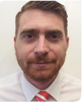
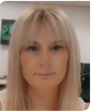
Minor Customer Connections Managers
Jacob Coates
Michael Hammond
Responsible for
Decarbonisation Application and Workforce Planning Performance Manager
Minor Connections Design Manager
Managing our Connections Service Centre for all customer applications
Assists our Minor Connections Customers throughout their journey from application all the way through to the delivery of the project
Process acceptances and payments for connections quotes
Drives the development for self service and automation of quoting
Manages the financial closure of projects
Jacob.coates@sse.com
michael.hammond@sse.com
07443 183350
Gemma Overall
Minor Connections Financial Reconciliation Manager
gemma.overall@sse.com
07721 505094
Points of escalation
1st point of escalation is
Minor Customer Connections Managers
2nd point of escalation is
Hayley Joynson
Head of Minor Connections
3rd point of escalation is
Andrew Scott
Director of Customer Service

Slide 8






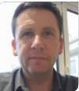



System Planning Design
Design - Responsible for
Designing & quoting required works for your connection
Providing guidance on design and quotation processes
Assessment of the network to ensure everything is within the allowances
david.ross@sse.com
07767 850982
Our Design team are happy to provide help and advice on the design and quotation process via phone or email If you would like to book a meeting regarding one or more prospective project(s), please contact
businessrelationships@sse.com
If you would like to book a meeting regarding one or more projects already in progress, please sign up to attend one of our monthly Connections Surgeries here:
www.ssen.co.uk/stakeholderevent/basicsearch/
dimitris.konstantinidis@sse.com
07919 924463
System Planners are responsible for assessing and designing improvements to our existing equipment and ensuring compliance with legal requirements.
They play a crucial part in enhancing the safety, security, and reliability of our electricity network and also help to find innovative solutions to support both current and future power demands .
simon.horne@sse.com
07767 852868
euan.davidson@sse.com
Points of escalation
07584 313825
1st point of escalation is
Design Managers and System Planning
2nd point of escalation is
Barry Will
Head of Connections, Design & Quotation SHEPD
james.mcneish@sse.com
07384 454411
3rd point of escalation is
Andrew Scott
Director of Customer Service

Slide 9
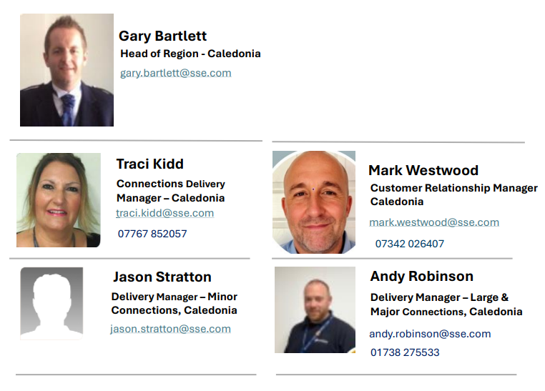
Large Capital Delivery - Caledonia
Responsible for
Major Projects and Large connections requiring 33/132kV works
Major Projects and Large connections requiring 33/132kV works
Large Capital Delivery is responsible for all large capital and customer connection projects
Delivery Groups are structured around grid supply points;
Each Delivery Group will be headed by a Project Director with senior project managers having responsibility for managing all projects within individual Grid Supply Points
Project managers have responsibility for delivery of individual projects.
Delivery Contract Partners will be appointed to each Delivery Group (tender currently in progress)
Points of escalation
1st point of escalation is
Managers (as over)
2nd point of escalation is
Keith Forbes
Head of Programme Delivery North
3rd point of escalation is
Fraser Hood
Director of Large Capital Delivery

Slide 10
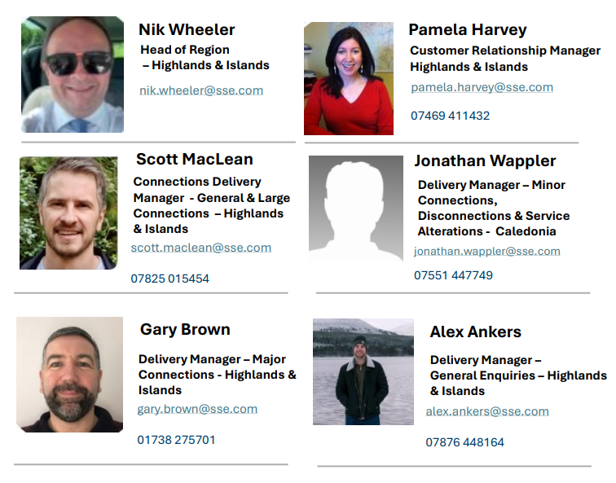
Large Capital Delivery
Responsible for
Major Projects and Large connections requiring 33/132kV works
Major Projects and Large connections requiring 33/132kV works
Large Capital Delivery is responsible for all large capital and customer connection projects
Delivery Groups are structured around grid supply points;
Each Delivery Group will be headed by a Project Director with senior project managers having responsibility for managing all projects within individual Grid Supply Points
Project managers have responsibility for delivery of individual projects.
Delivery Contract Partners will be appointed to each Delivery Group (tender currently in progress)
Points of escalation
1st point of escalation is
Project Directors
2nd point of escalation is
Keith Forbes
Head of Programme Delivery North
3rd point of escalation is
Fraser Hood
Director of Large Capital Delivery

Slide 11

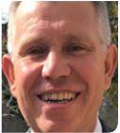
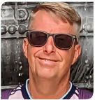
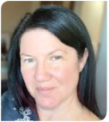
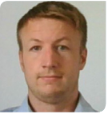
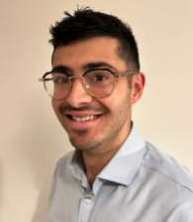
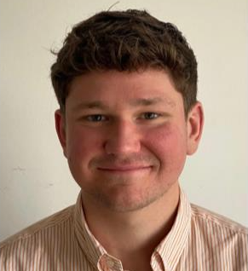
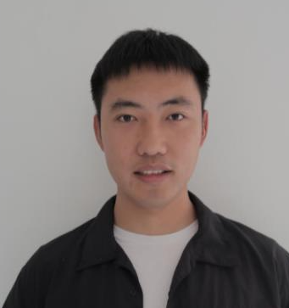
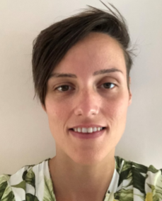
Flexible Services
Gavin Stewart
Mark Homann
Flexible Solutions Manager
Lead Project Delivery Manager
gavin.stewart@sse.com
mark.homann@sse.com
Responsible for
07767 850006
07584 313225
Dean Miles
Jenny Lindsay
Flexible Solutions Delivery Engineer
Flexible Solutions Support Technician
Overseeing the roll out of certain proven innovations that require more support once they have been installed and commissioned.
Currently this means they are responsible for rolling out Active Network Management and other types of flexible connections across both our distribution areas, north and south for the benefits of your connection and to the UK customer in general.
If you have any queries in regard to Flexible Connection opportunities, please contact:
flexible.connections@sse.com
dean.miles@sse.com
jenny.lindsay@sse.com
07747 559091
07443 173311
Iain Prentice
Oliver Cooper
Flexible Solutions Delivery Engineer
Flexible Solutions Project Manager
iain.prentice@sse.com
oliver.cooper@sse.com
07342 027519
07425 426830
John Boundy
Jiabin Fan
Flexible Solutions Project Engineer
Flexibility Scheduling Engineer
john.boundy@sse.com
jiabin.fan@sse.com
Points of escalation
07342 027805
07493 881672
Corinna Farrell
1st point of escalation is
Gavin Stewart
Flexible Solutions Manager
Flexible Solutions Performance Manager
corinna.farrell@sse.com
07385 430460

Slide 12
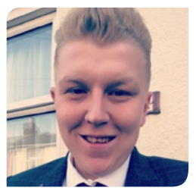
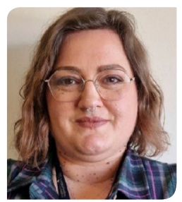
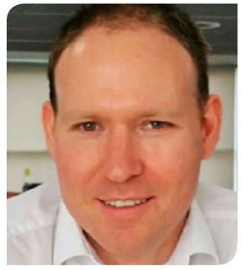
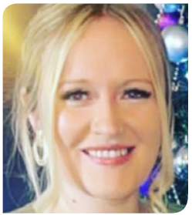


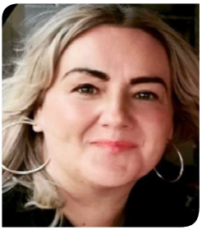
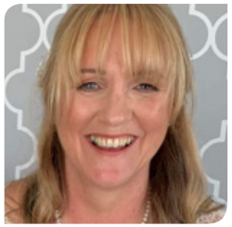
Customer Service, Vulnerability & Strategy
Responsible for
Customer Service Strategy for SSEN
ED2 Customer Strategy Objectives
Customer Vulnerability Strategy
Service Design Authority for SSEN
Customer Change & Improvement portfolio
Strategic oversight of welfare during storms & welfare/ manual framework
PSR Social Obligations & Strategy
Customer Digital Strategy & Website ownership
Customer Performance & Standards. Insight Analysis & Reporting
Troy Fisher
Emma Merritt
Customer Journey & Experience Design Lead
Customer Vulnerability & Communities Lead
troy.fisher@sse.com
emma.merritt@sse.com
07887 943075
07469 411043
David Yule
Customer Business Improvement & Planning Lead
david.yule@sse.com
Engage with us
Rebecca Priestley
Bradley Smith
Sign up to our Connections mailing list
View our event calendar
Visit our Webpage
Journey Owner – Minor Connections & General Enquiries
Journey Owner – Digital
rebecca.priestley@sse.com
bradley.smith@sse.com
07810 817502
07586 282010
Abigail Furey
Jane Bakella
Points of escalation
Journey Owner – Large & Major Connections
Journey Owner – Interruptions & Complaints
abigail.furey@sse.com
jane.bakella@sse.com
1st point of escalation is
Troy Fisher
Customer Journey & Experience Design Lead
07436 491626
01738 344607
Debbie Cloke
2nd point of escalation is
Andrew Bailey
Head of Customer Service & Stakeholder Strategy
Engagement Coordinator
debbie.cloke@sse.com
3rd point of escalation is
Andrew Scott
Director of Large Capital Project Delivery
07741 127752

Slide 13
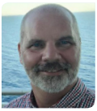
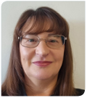



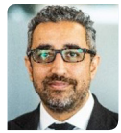
Customer Contact Centres
Mark Wells
Lorraine Barber
Performance Manager - North
Performance Manager - South
mark.wells@sse.com
lorraine.barber@sse.com
Responsible for
07920 237540
07990 424985
Aimee Wiles
Jade Law
Interface with the SSEN customer for faults & general enquiries
Customer interface during storms
Written, digital, telephony & verbal interaction with customers
Customer complaints & executive complaints
Resource management of Contact Centres
Performance Manager – GE and Social Media
Complaints Manager
aimee.wiles@sse.com
jade.law@sse.com
07496 869728
07920 167987
Louise Jones
Social Obligations Manager
louise.jones@sse.com
Legal
Points of escalation
Raaj is a commercial property solicitor and is the Head of Legal (Property) Distribution, based in our Reading office, advising on property, planning and environmental issues.
Raaj leads a team of 10 lawyers based across Reading, Perth, Glasgow and Inverness. His team spend most of their time working on real estate transactions for SEPD / SHEPD. Between the in-house team and the external panel firms, Raaj steers c.3,000 live transactions
Raaj Bains
1st point of escalation is
Jade Law
Complaints Manager
Head of Legal
raaj.bains@sse.com
07876 837450
2nd point of escalation is
Gemma Wilson
Head of Customer Contact Centres
3rd point of escalation is
Andrew Scott
Director of Customer Service

Slide 14

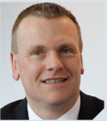
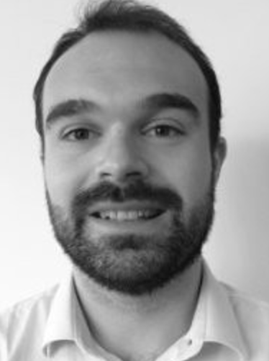




The end-to-end connections customer journey is the sole responsibility of the Customer Service Directorate. This change, brought about in 2023, provides our customers and stakeholders visibility of staff responsibility and accountability throughout the journey, from application to delivery.
Responsible for
Andrew Scott
Director of Customer Service
andrew.m.scott@sse.com
Mark Askew
Barry Will
Hayley Joynson
Head of
Connections, Policy & Performance
Head of Connections Design & Quotation (North))
Head of Minor Customer
Connections
barry.will@sse.com
mark.askew@sse.com
07767 852098
hayley.joynson@sse.com
Andrew Bailey
Gemma Wilson
Head of Customer Service Strategy & Vulnerability
Head of Customer Contact Centres
gemma.wilson@sse.com
andrew.bailey2@sse.com
07919 907484

Slide 15







Compliments & Complaints
Engage with us
Compliments
Sign up to our Connections mailing list
View our event calendar
Read our regulatory ICE submissions
Visit our Webpage
We are keen to hear your good news stories and positive experiences with our team members. If you have received particularly good service, why not commend the person or team responsible? It lets us know what we are doing right, highlights good working practices that we can all adopt and encourages certain ways of working. Compliments can be sent to the Connections Engagement team at:
Engage with us on social media
connectionsfeedback@sse.com
Complaints
We always aim to provide the best service possible, however we do understand that sometimes we don’t always get it right. If you should experience this, and would like to raise a complaint you can do this via telephone, email or online
The easiest and quickest way to resolve a complaint is to telephone us: 0800 980 1395
Monday to Saturday between 08:00 – 16:00
If you are unable to phone or would prefer to write, you can contact us by email:
customercomplaints@ssen.co.uk
You can also complete our online complaints form: www.ssen.co.uk/Complaints
If you have any ideas for improvement of this guide please let us know:
connectionsfeedback@sse.com
businessrelationships@sse.com
Notes:
Hyperlinks to be included

